Slide 1
CS 2420: Tree
Dr. Tsung-Wei (TW) Huang
Department of Electrical and Computer Engineering
University of Utah, Salt Lake City, UT

Slide 2
Outline
In this topic, we will cover:
Definition of a tree data structure and its components
Concepts of:
Root, internal, and leaf nodes
Parents, children, and siblings
Paths, path length, height, and depth
Ancestors and descendants
Ordered and unordered trees
Subtrees
Examples
XHTML and CSS

Slide 3
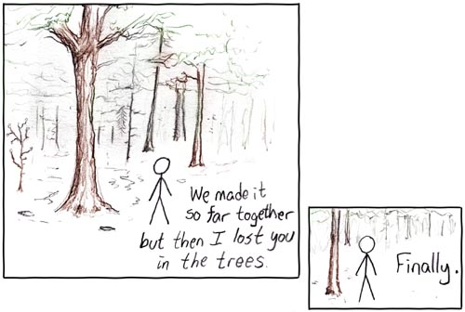
Abstract Deque
Trees are the first data structure different from what you’ve seen in your first-year programming courses

Slide 4
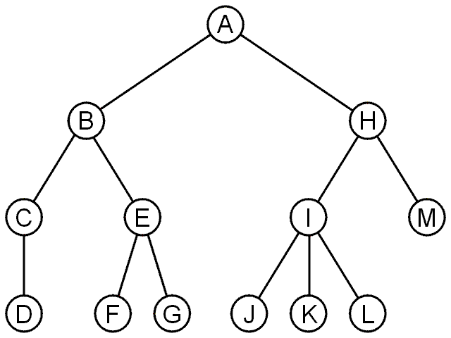
Tree
A rooted tree data structure stores information in nodes
Similar to linked lists:
There is a first node, or root
Each node has variable number of references to successors
Each node, other than the root, has exactly one node pointing to it

Slide 5
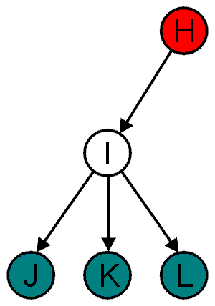
Terminology
All nodes will have zero or more child nodes or children
I has three children: J, K and L
For all nodes other than the root node, there is one parent node
H is the parent I

Slide 6
Terminology
The degree of a node is defined as the number of its children: deg(I) = 3
Nodes with the same parent are siblings
J, K, and L are siblings

Slide 7
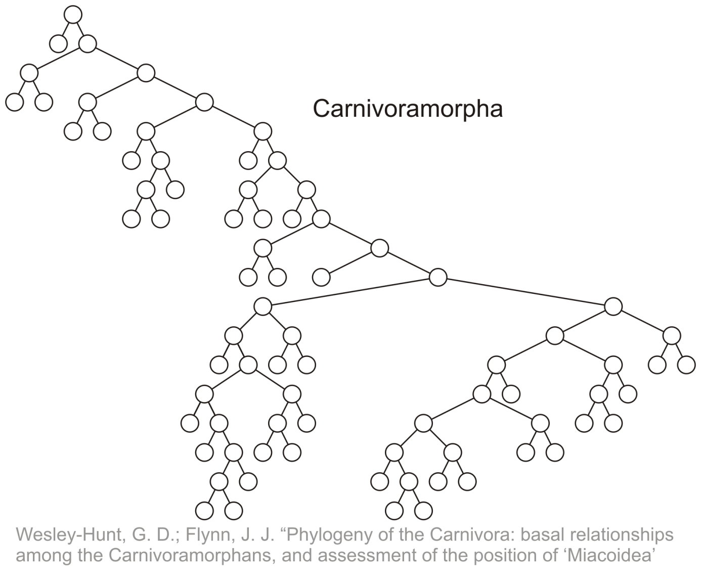
Terminology
Phylogenetic trees have nodes with degree 2 or 0:

Slide 8
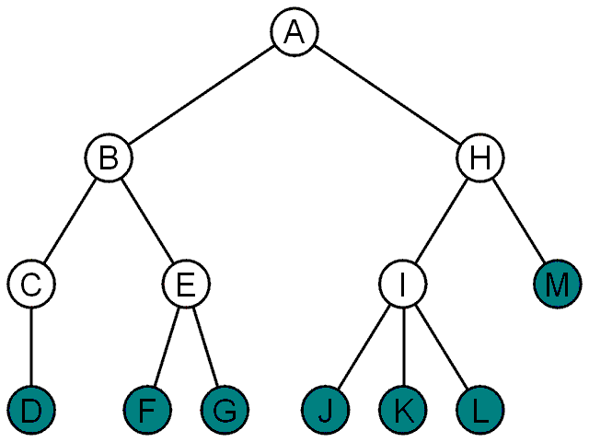
Terminology
Nodes with degree zero are also called leaf nodes
All other nodes are said to be internal nodes, that is, they are internal to the tree

Slide 9
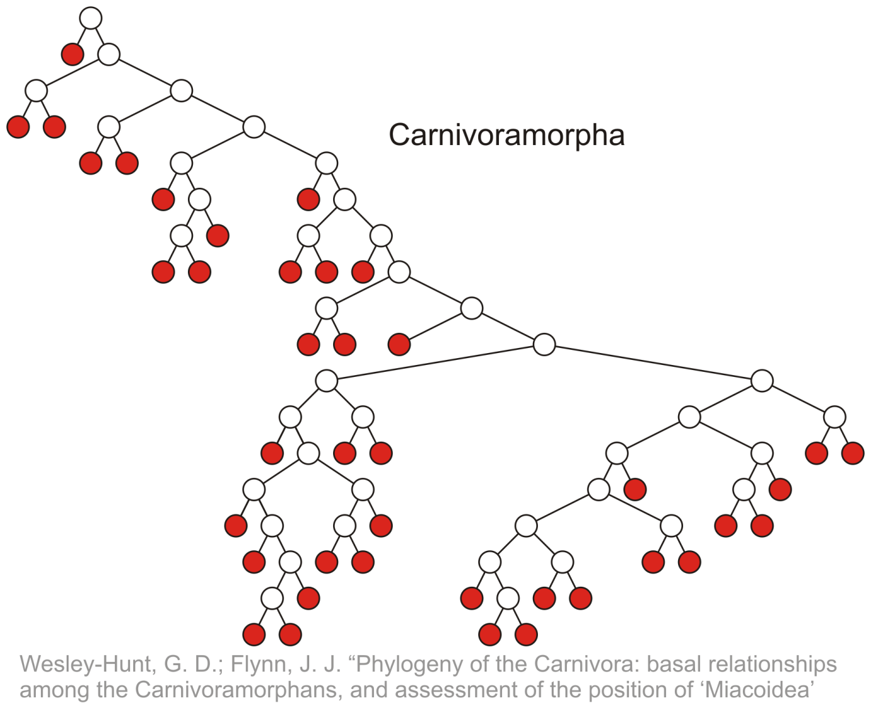
Terminology
Leaf nodes:

Slide 10
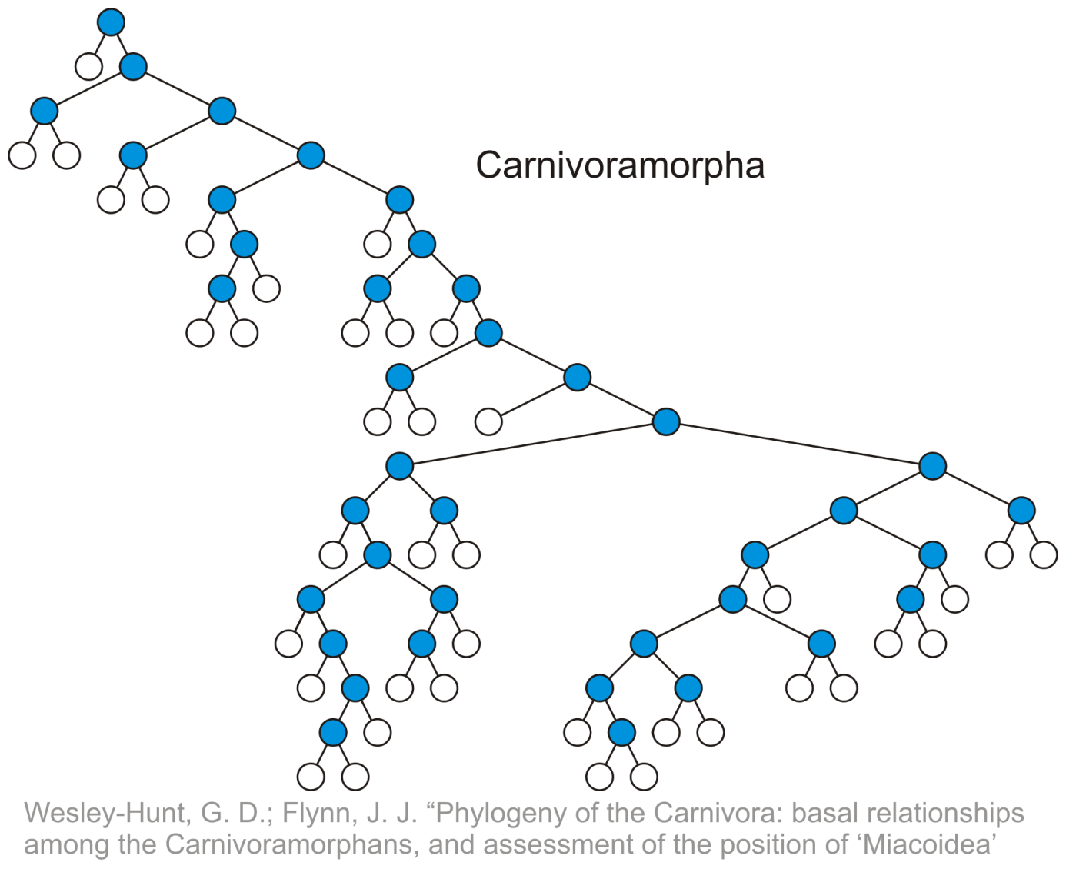
Terminology
Internal nodes:

Slide 11
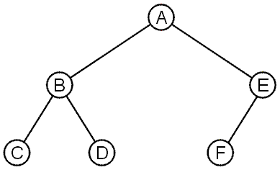
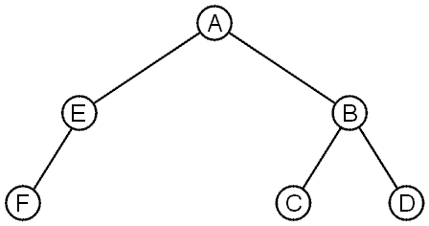
Terminology
These trees are equal if the order of the children is ignored
unordered trees
They are different if order is relevant (ordered trees)
We will usually examine ordered trees (linear orders)
In a hierarchical ordering, order is not relevant

Slide 12
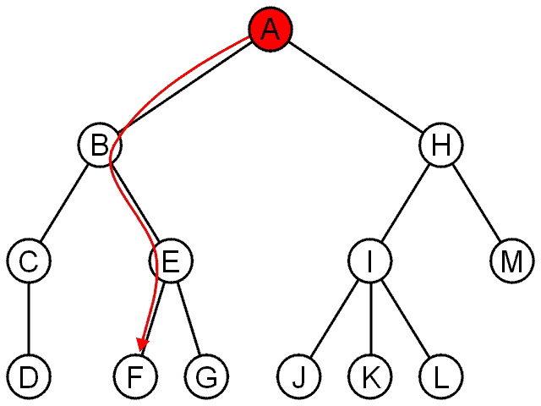
Terminology
The shape of a rooted tree gives a natural flow from the root node, or just root

Slide 13
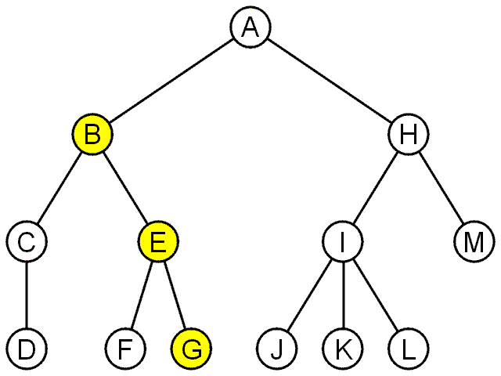
Terminology
A path is a sequence of nodes
(a₀, a₁, ..., a_{n})
where a_{k + 1} is a child of a_{k} is
The length of this path is n
E.g., the path (B, E, G) has length 2

Slide 14
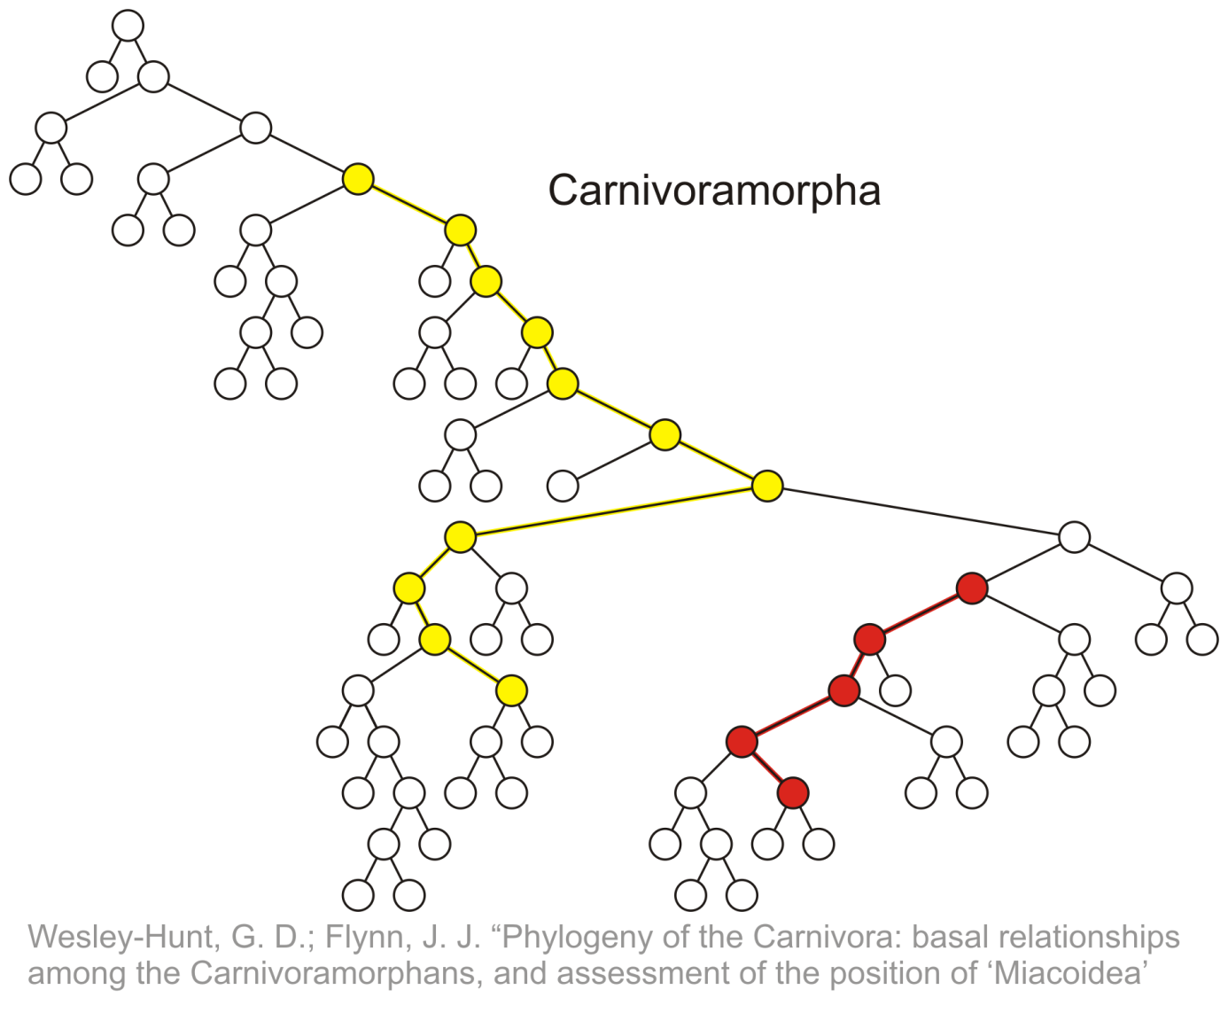
Terminology
Paths of length 10 (11 nodes) and 4 (5 nodes)
Start of these paths
End of these paths

Slide 15
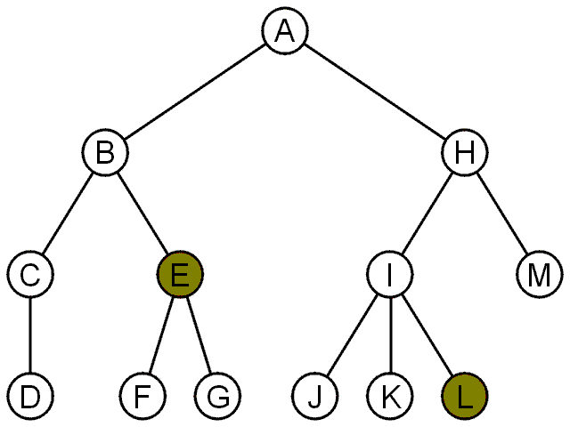
Terminology
For each node in a tree, there exists a unique path from the root node to that node
The length of this path is the depth of the node, e.g.,
E has depth 2
L has depth 3

Slide 16
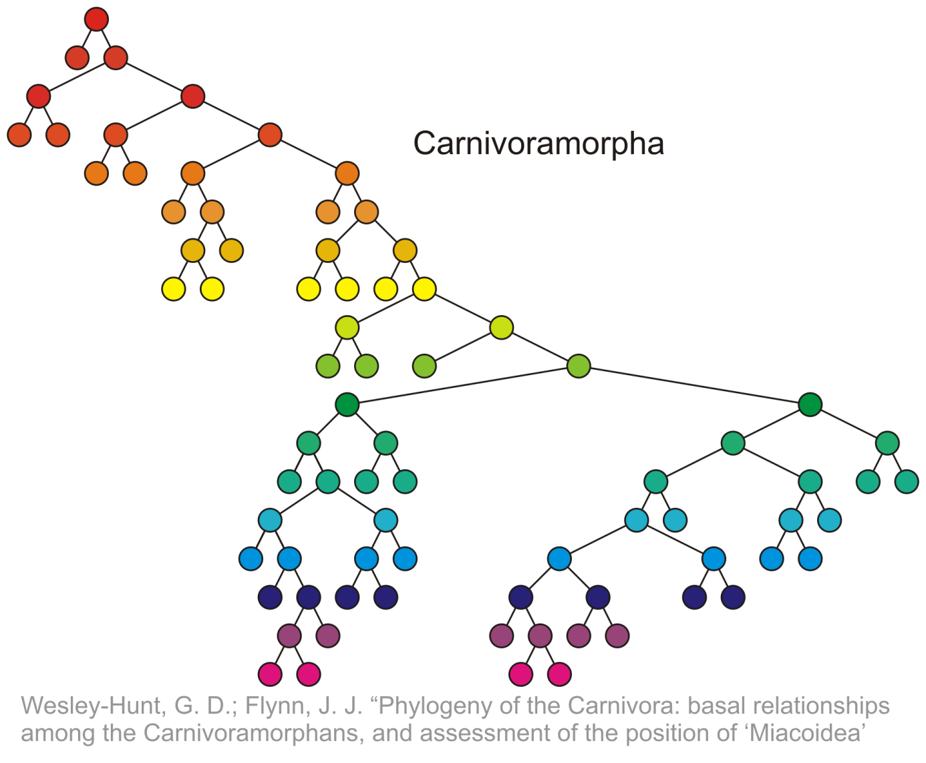
Terminology
Depth 17
0
4
9
14
17

Slide 17
Terminology
The height of a tree is defined as the maximum depth of any node within the tree
The height of a tree with one node is 0
Just the root node
For convenience, we define the height of the empty tree to be –1

Slide 18
Terminology
The height of this tree is 17
17

Slide 19
Terminology
If a path exists from node a to node b:
a is an ancestor of b
b is a descendent of a
Thus, a node is both an ancestor and a descendant of itself
We can add the adjective strict to exclude equality: a is a strict descendent of b if a is a descendant of b but a ≠ b
The root node is an ancestor of all nodes

Slide 20
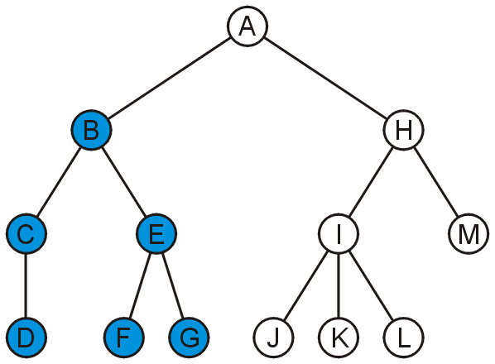
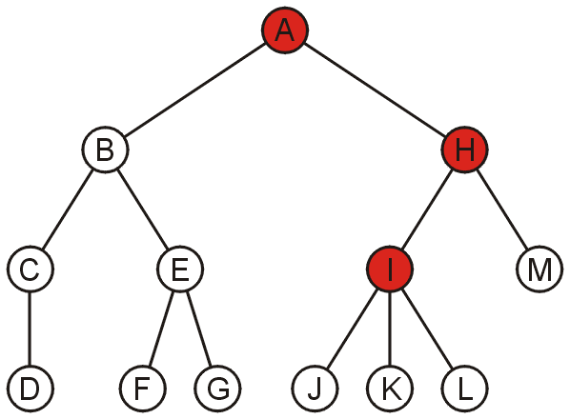
Terminology
The descendants of node B are B, C, D, E, F, and G:
The ancestors of node I are I, H, and A:

Slide 21
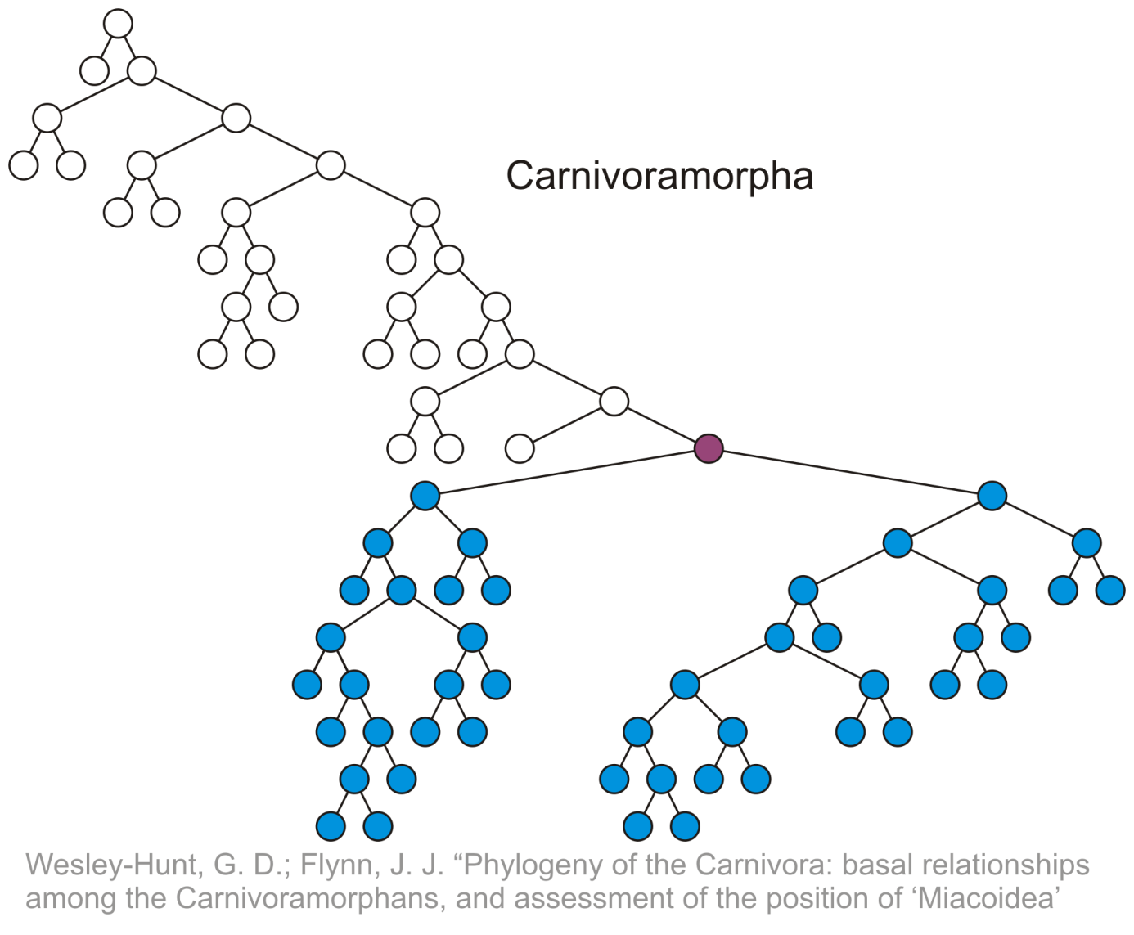
Terminology
All descendants (including itself) of the indicated node

Slide 22
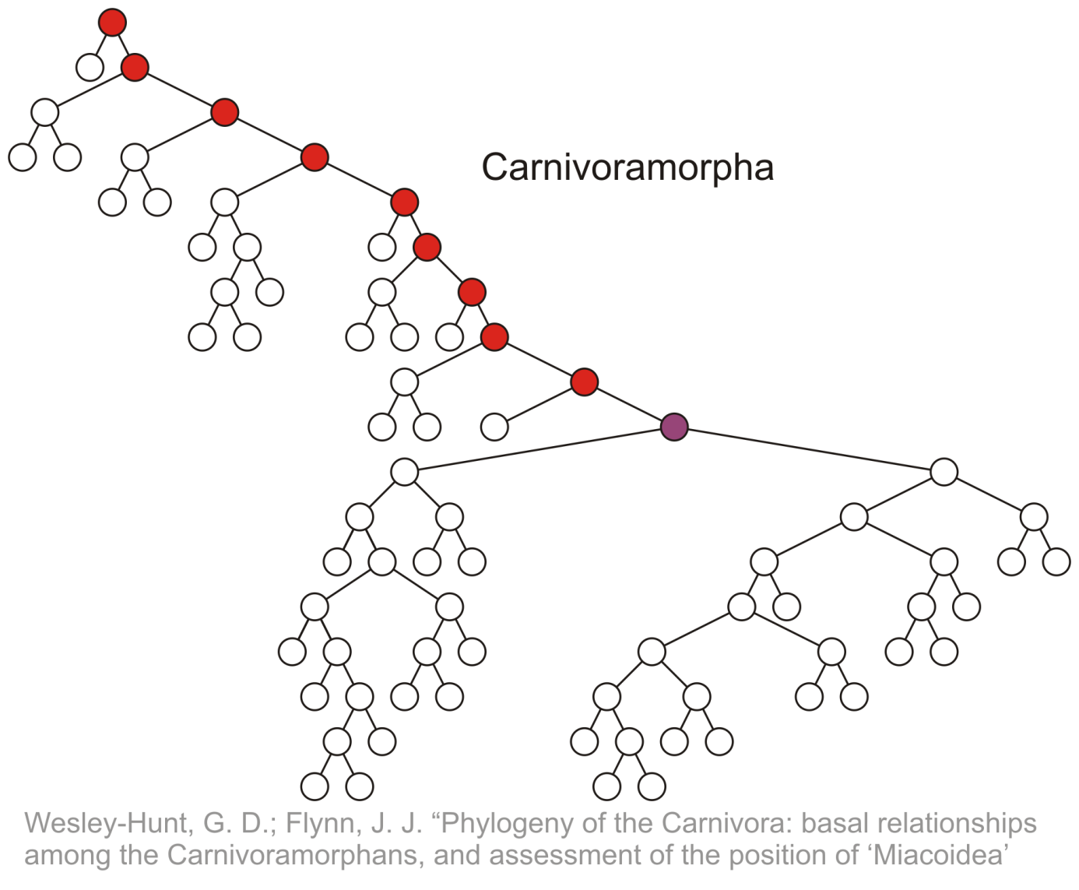
Terminology
All ancestors (including itself) of the indicated node

Slide 23
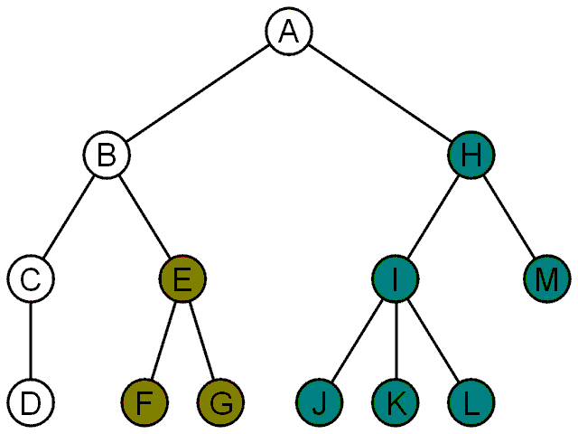
Terminology
Another approach to a tree is to define the tree recursively:
A degree-0 node is a tree
A node with degree n is a tree if it has n children and all of its children are disjoint trees (i.e., with no intersecting nodes)
Given any node a within a tree with root r, the collection of a and all of its descendants is said to be a subtree of the tree with root a

Slide 24
Example: XHTML and CSS
The XML of XHTML has a tree structure
Cascading Style Sheets (CSS) use the tree structure to modify the display of HTML

Slide 25
Example: XHTML and CSS
Consider the following XHTML document
<html>
<head>
<title>Hello World!</title>
</head>
<body>
<h1>This is a <u>Heading</u></h1>
<p>This is a paragraph with some
<u>underlined</u> text.</p>
</body>
</html>

Slide 26
Example: XHTML and CSS
Consider the following XHTML document
<html>
<head>
<title>Hello World!</title>
</head>
<body>
<h1>This is a <u>Heading</u></h1>
<p>This is a paragraph with some
<u>underlined</u> text.</p>
</body>
</html>
title
heading
body of page
underlining
paragraph

Slide 27
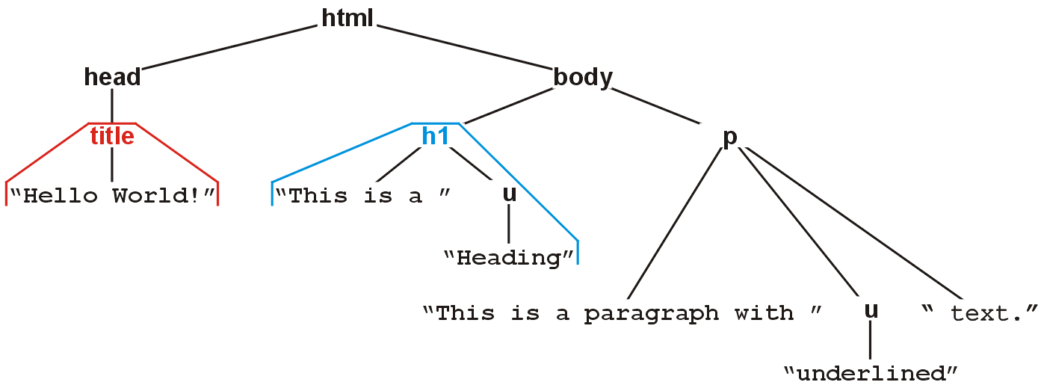
Example: XHTML and CSS
The nested tags define a tree rooted at the HTML tag
<html>
<head>
<title>Hello World!</title>
</head>
<body>
<h1>This is a <u>Heading</u></h1>
<p>This is a paragraph with some
<u>underlined</u> text.</p>
</body>
</html>

Slide 28

Example: XHTML and CSS
Web browsers render this tree as a web page

Slide 29
Example: XHTML and CSS
XML tags <tag>...</tag> must be nested
For example, to get the following effect:
1 2 3 4 5 6 7 8 9
you may use
<u>1 2 3 <b>4 5 6</b></u><b> 7 8 9</b>
You may not use:
<u>1 2 3 <b>4 5 6</u> 7 8 9</b>

Slide 30
Example: XHTML and CSS
Cascading Style Sheets (CSS) make use of this tree structure to describe how HTML should be displayed
For example:
<style type="text/css">
h1 { color:blue; }
</style>
indicates all text/decorations descendant from an h1 header should be blue

Slide 31
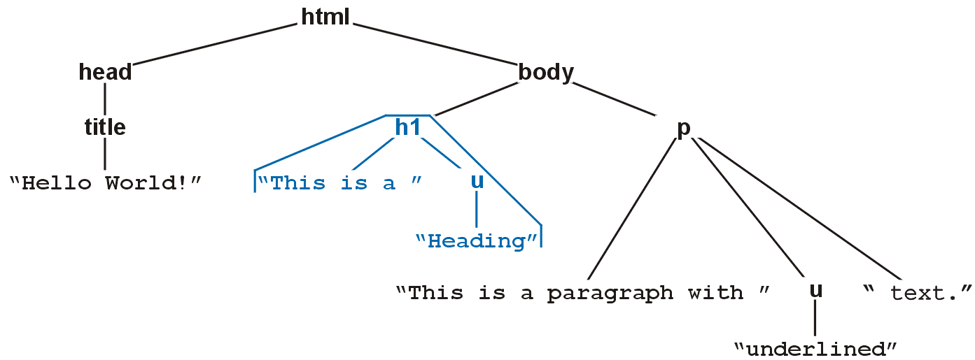

Example: XHTML and CSS
For example, this style renders as follows:
<style type="text/css">
h1 { color:blue; }
</style>

Slide 32
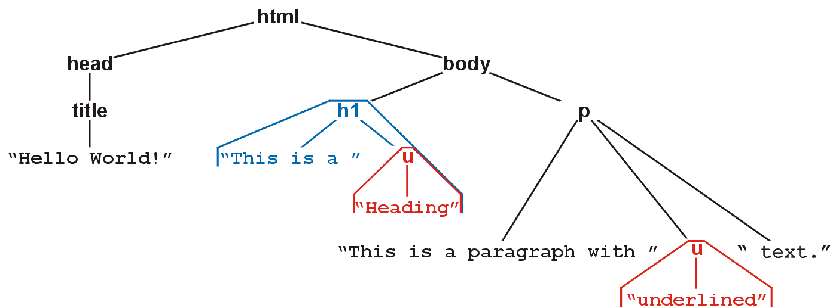

Example: XHTML and CSS
For example, this style renders as follows:
<style type="text/css">
h1 { color:blue; }
u { color:red; }
</style>

Slide 33
Example: XHTML and CSS
Suppose you don’t want underlined items in headers (h1) to be red
More specifically, suppose you want any underlined text within paragraphs to be red
That is, you only want text marked as <u>text</u> to be underlined if it is a descendant of a <p> tag

Slide 34
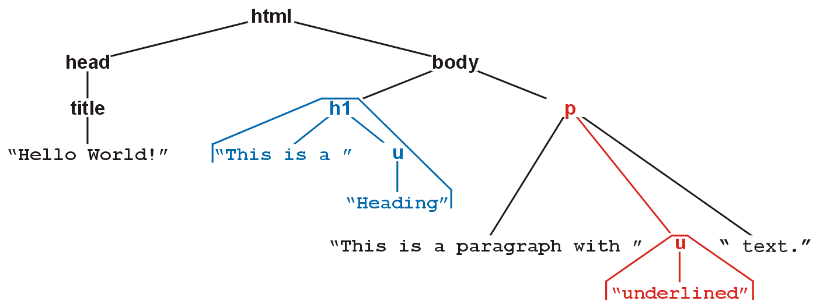

Example: XHTML and CSS
For example, this style renders as follows:
<style type="text/css">
h1 { color:blue; }
p u { color:red; }
</style>

Slide 35
Example: XHTML and CSS
You can read the second style
<style type="text/css">
h1 { color:blue; }
p u { color:red; }
</style>
as saying “text/decorations descendant from the underlining tag (<u>) which itself is a descendant of a paragraph tag should be coloured red”

Slide 36
Example: XML
In general, any XML can be represented as a tree
All XML tools make use of this feature
Parsers convert XML into an internal tree structure
XML transformation languages manipulate the tree structure
E.g., XMLT

Slide 37
MathML: x² + y² = z²
<math xmlns="http://www.w3.org/1998/Math/MathML">
<semantics>
<mrow><mrow><msup><mi>x</mi><mn>2</mn></msup><mo>+</mo>
<msup><mi>y</mi><mn>2</mn></msup></mrow>
<mo>=</mo><msup><mi>z</mi><mn>2</mn></msup></mrow>
<annotation-xml encoding="MathML-Content">
<apply><eq/>
<apply><plus/>
<apply><power/><ci>x</ci><cn>2</cn></apply>
<apply><power/><ci>y</ci><cn>2</cn></apply>
</apply>
<apply><power/><ci>z</ci><cn>2</cn></apply>
</apply>
</annotation-xml>
<annotation encoding="Maple">x^2+y^2 = z^2</annotation>
</semantics>
</math>

Slide 38
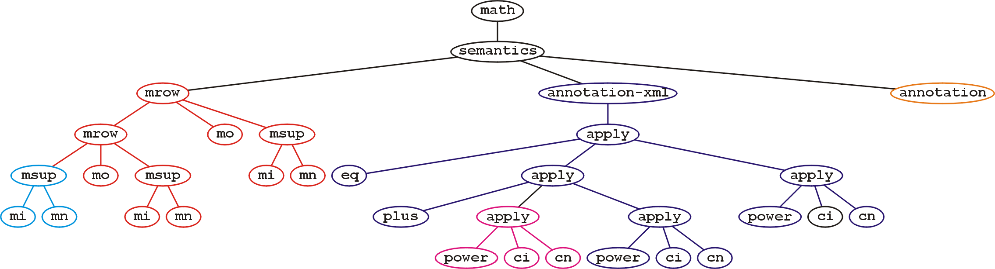
MathML: x² + y² = z²
The tree structure for the same MathML expression is

Slide 39
MathML: x² + y² = z²
Why use 500 characters to describe the equation
x² + y² = z²
which, after all, is only twelve characters (counting spaces)?
The root contains three children, each different codings of:
How it should look (presentation),
What it means mathematically (content), and
A translation to a specific language (Maple)

Slide 40
Abstract Trees
An abstract tree (or abstract hierarchy) does not restrict the number of nodes
In this tree, the degrees vary:
Degree | Nodes
0 | D, F, G, J, K, L, M
1 | C
2 | A, B, E, H
3 | I

Slide 41
Abstract Trees: Design
We implement an abstract tree or hierarchy by using a class that:
Stores a value
Stores the children in a linked-list

Slide 42
Implementation
The class definition would be:
template <typename Type>
class Simple_tree {
private:
Type node_value;
Simple_tree *parent_node;
std::list<Simple_tree *> children;
public:
Simple_tree( Type const & = Type(), Simple_tree * = nullptr );
Type value() const;
Simple_tree *parent() const;
int degree() const;
bool is_root() const;
bool is_leaf() const;
Simple_tree *child( int n ) const;
int height() const;
void insert( Type const & );
void attach( Simple_tree * );
void detach();
};

Slide 43
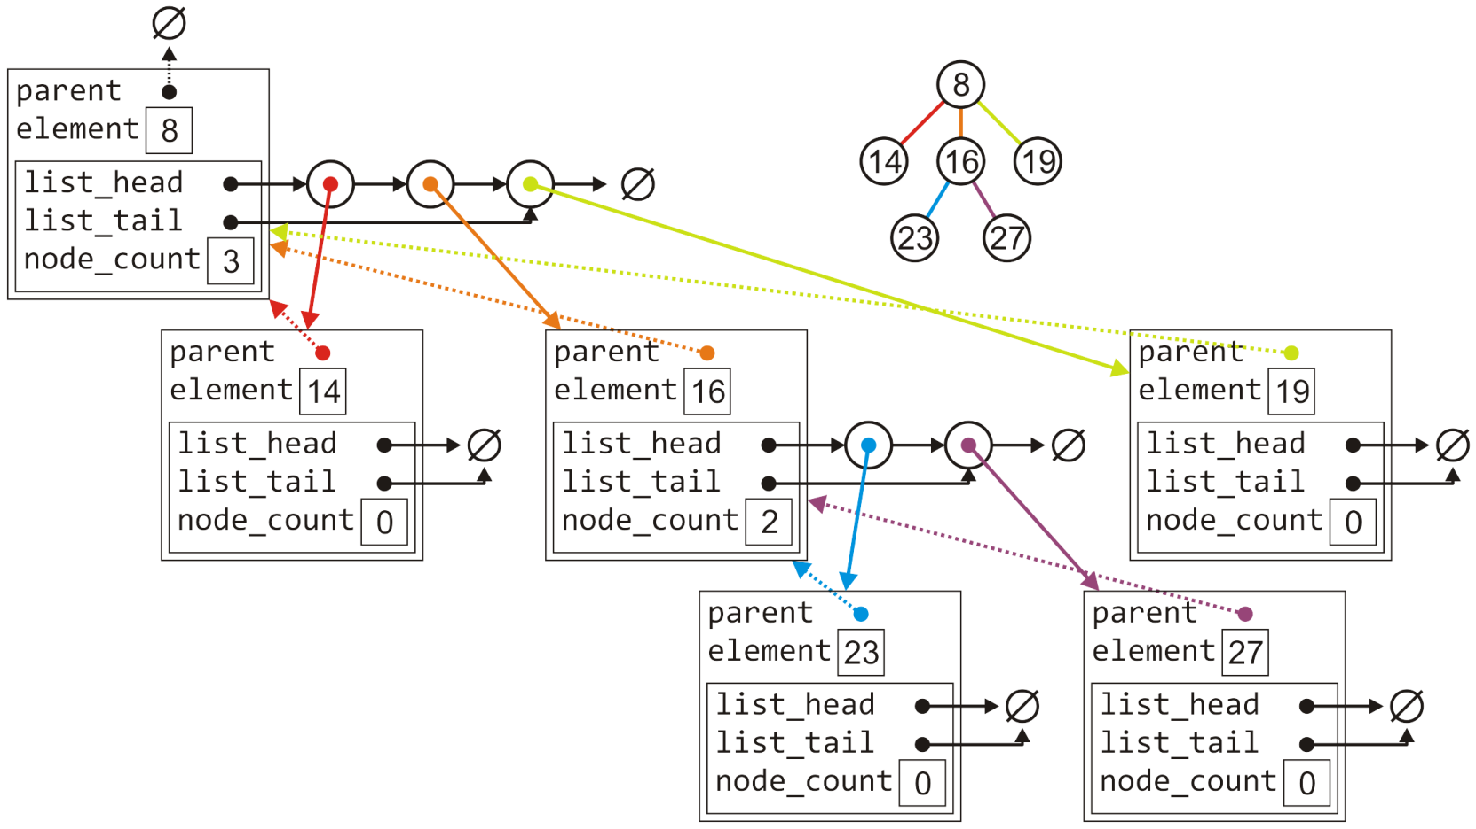
Implementation
The tree with six nodes would be stored as follows:

Slide 44
Implementation
Much of the functionality is similar to that of the list class:
template <typename Type>
Simple_tree<Type>::Simple_tree( Type const &obj, Simple_tree *p ):
node_value( obj ),
parent_node( p ) {
// Empty constructor
}
template <typename Type>
Type Simple_tree<Type>::value() const {
return node_value;
}
template <typename Type>
Simple_tree<Type> *Simple_tree<Type>::parent() const {
return parent_node;
}

Slide 45
Implementation
Much of the functionality is similar to that of the list class:
template <typename Type>
bool Simple_tree<Type>::is_root() const {
return ( parent() == nullptr );
}
template <typename Type>
int Simple_tree<Type>::degree() const {
return children.size();
}
template <typename Type>
bool Simple_tree<Type>::is_leaf() const {
return ( degree() == 0 );
}

Slide 46
Implementation
Accessing the n^{th} child requires a for loop (Θ(n)):
template <typename Type>
Simple_tree<Type> *Simple_tree<Type>::child( int n ) const {
if ( n < 0 || n >= degree() ) {
return nullptr;
}
auto *child = children.head();
// Skip the first n - 1 children
for ( int i = 1; i < n; ++i ) {
child = child->next();
}
return child->value();
}

Slide 47
Implementation
Attaching a new object to become a child is similar to a linked list:
template <typename Type>
void Simple_tree<Type>::attach( Type const &obj ) {
children.push_back( new Simple_tree( obj, this ) );
}

Slide 48
Implementation
To detach a tree from its parent:
If it is already a root, do nothing
Otherwise, erase this object from the parent’s list of children and set the parent pointer to zero
template <typename Type>
void Simple_tree<Type>::detach() {
if ( is_root() ) {
return;
}
parent()->children.erase( this );
parent_node = nullptr;
}

Slide 49
Implementation
Attaching an entirely new tree as a sub-tree, however, first requires us to check if the tree is not already a sub-tree of another node:
If so, we must detach it first and only then can we add it
template <typename Type>
void Simple_tree<Type>::attach( Simple_tree<Type> *tree ) {
if ( !tree->is_root() ) {
tree->detach();
}
tree->parent_node = this;
children.push_back( tree );
}

Slide 50
Implementation
Suppose we want to find the size of a tree:
An empty tree has size 0, a tree with no children has size 1
Otherwise, the size is one plus the size of all the children
template <typename Type>
int Simple_tree<Type>::size() const {
if ( this == nullptr ) {
return 0;
}
int tree_size = 1;
for ( auto *child = children.begin(); child != children.end(); child = child->next() ) {
tree_size += child->value()->size();
}
return tree_size ;
}

Slide 51
Implementation
Suppose we want to find the height of a tree:
An empty tree has height –1 and a tree with no children is height 0
Otherwise, the height is one plus the maximum height of any sub tree
#include <algorithm>
template <typename Type>
int Simple_tree<Type>::height() const {
if ( this == nullptr ) {
return -1;
}
int tree_height = 0;
for ( auto *child = children.begin(); child != children.end(); child = child->next() ) {
tree_height = std::max( h, 1 + child->value()->height() );
}
return tree_height;
}

Slide 52
Implementation
Implementing a tree by storing the children in an array is similar, however, we must deal with the full structure
A general tree using an array would have a constructor similar to:
template <typename Type>
Simple_tree<Type>::Simple_tree( Type const &obj, Simple_tree *p ):
node_value( obj ),
parent_node( p ),
child_count( 0 ),
child_capacity( 4 ),
children( new Simple_tree *[child_capacity] ) {
// Empty constructor
}

Slide 53
Summary
In this topic, we have:
Introduced the terminology used for the tree data structure
Discussed various terms which may be used to describe the properties of a tree, including:
root node, leaf node
parent node, children, and siblings
ordered trees
paths, depth, and height
ancestors, descendants, and subtrees
We looked at XHTML and CSS
We have looked at one implementation of a general tree:
store the value of each node
store all the children in a linked list
not an easy (Θ(1)) way to access children
if we use an array, different problems...

